Slide 1
Chapter 5
Recursion

Slide 2
Basically, a method is recursive
if it includes a call to itself.

Slide 3
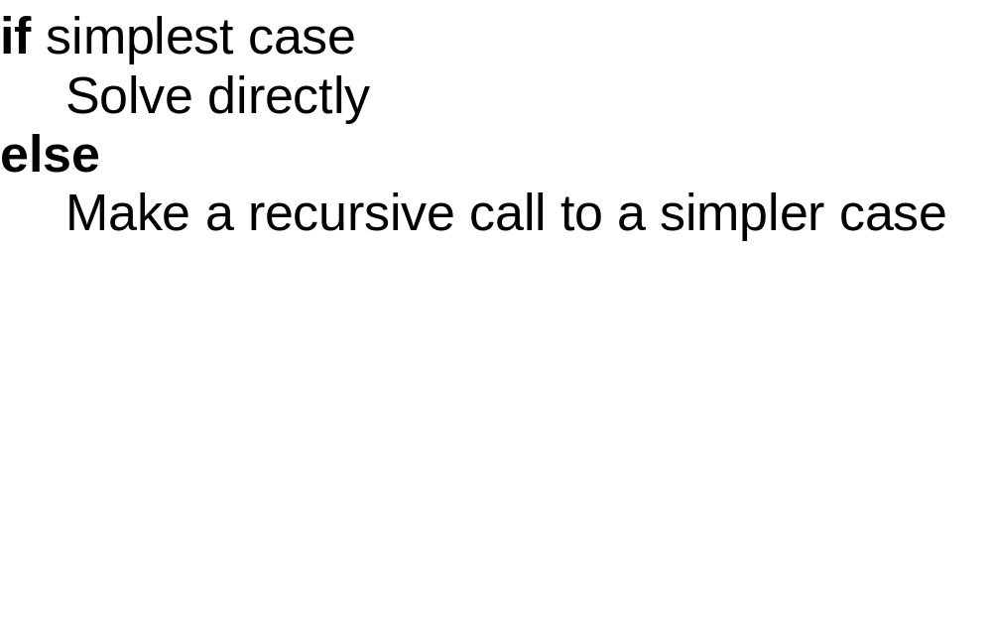

Slide 4
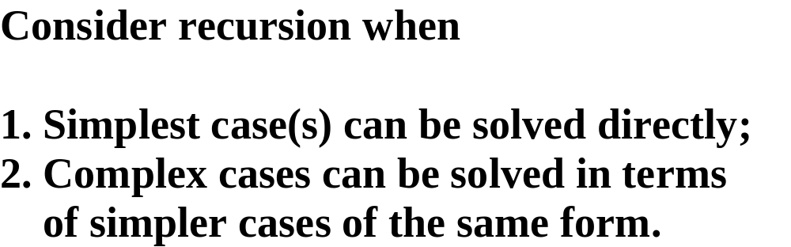

Slide 6
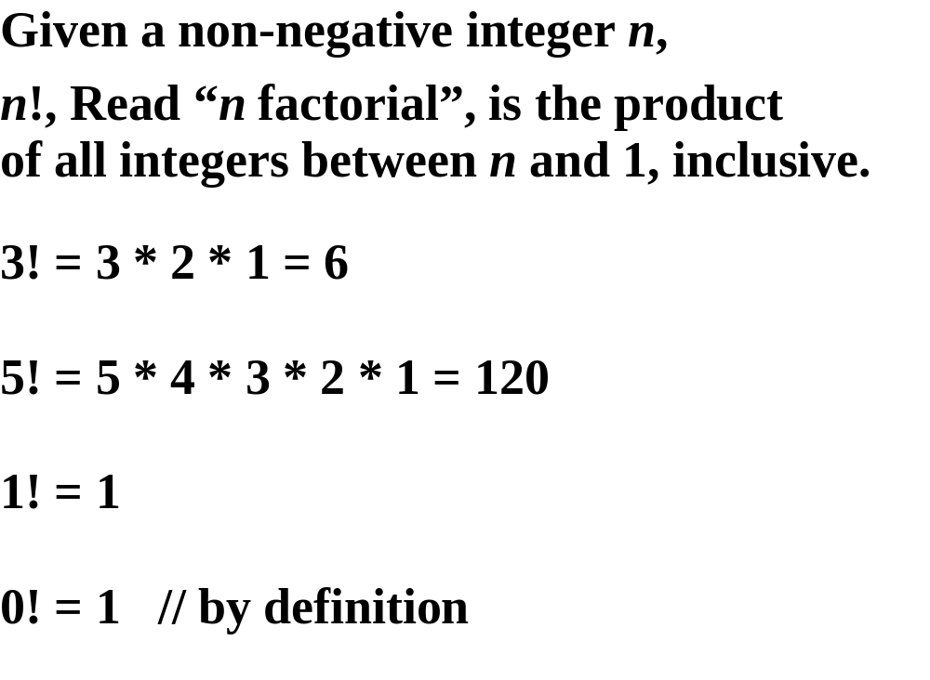

Slide 7
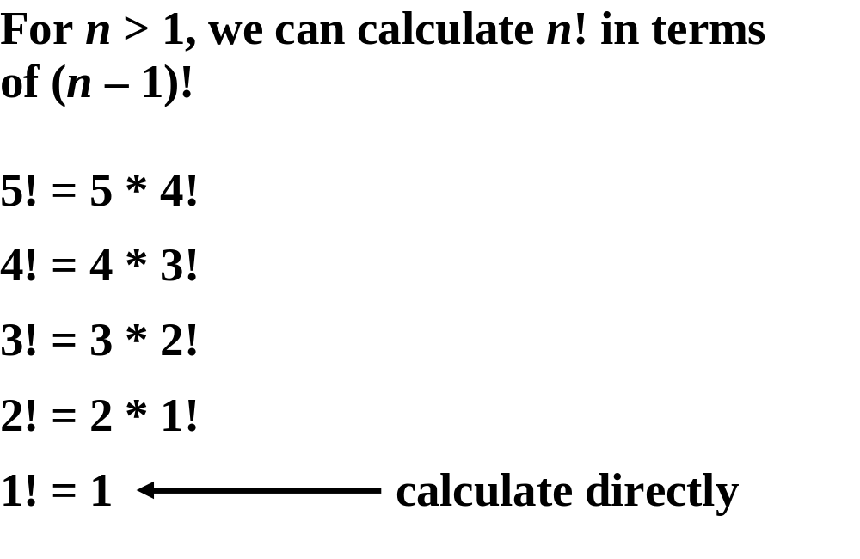

Slide 8
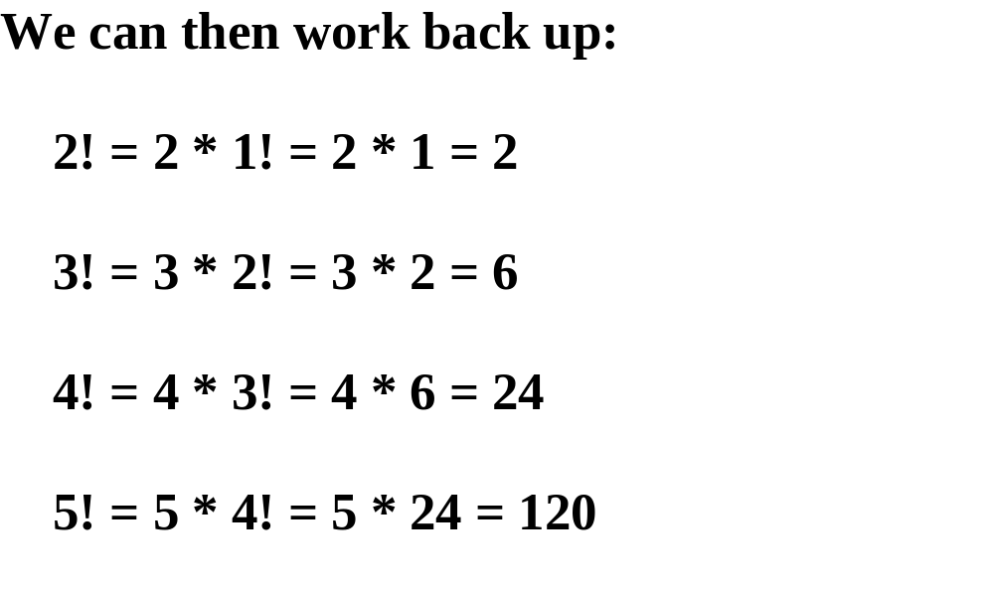

Slide 9
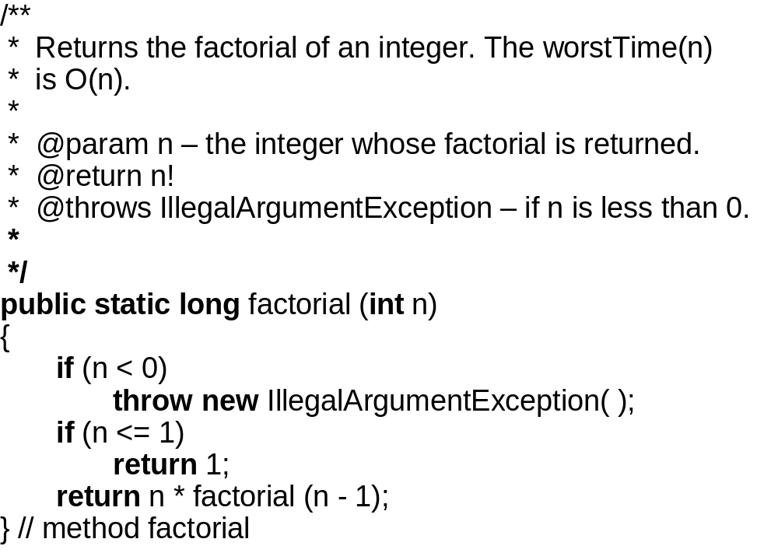

Slide 10
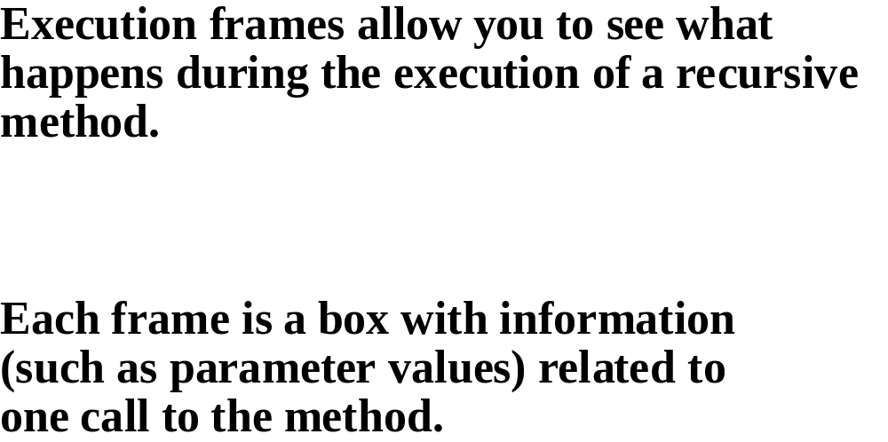

Slide 11
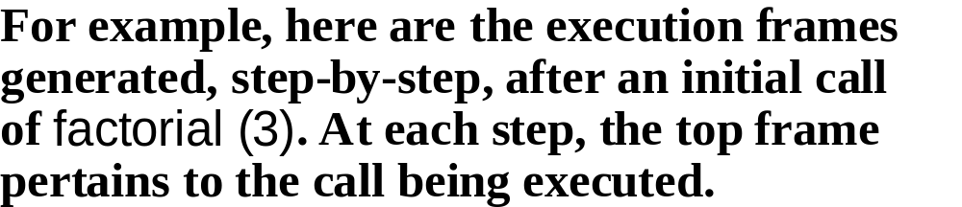

Slide 12
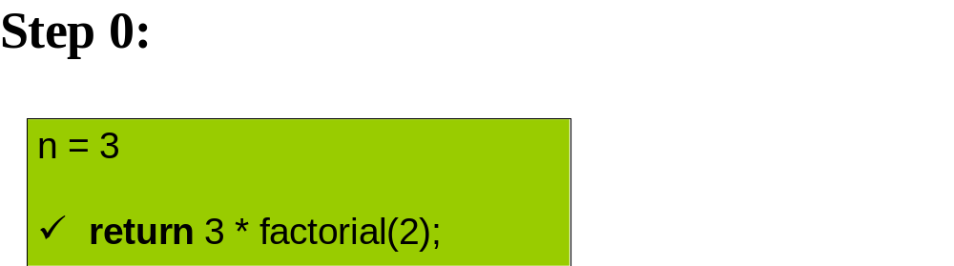

Slide 13
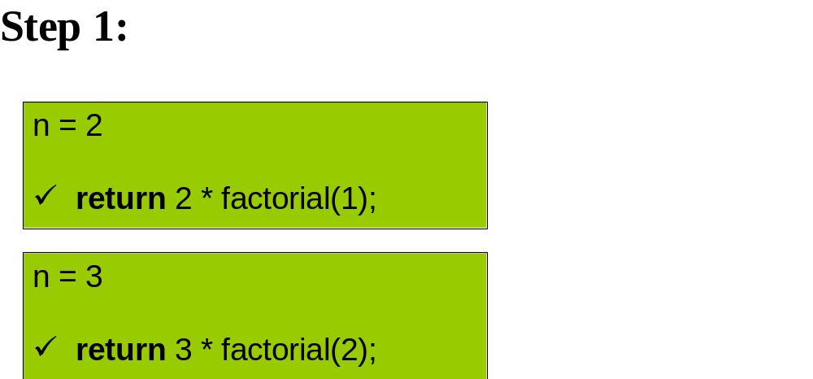

Slide 14
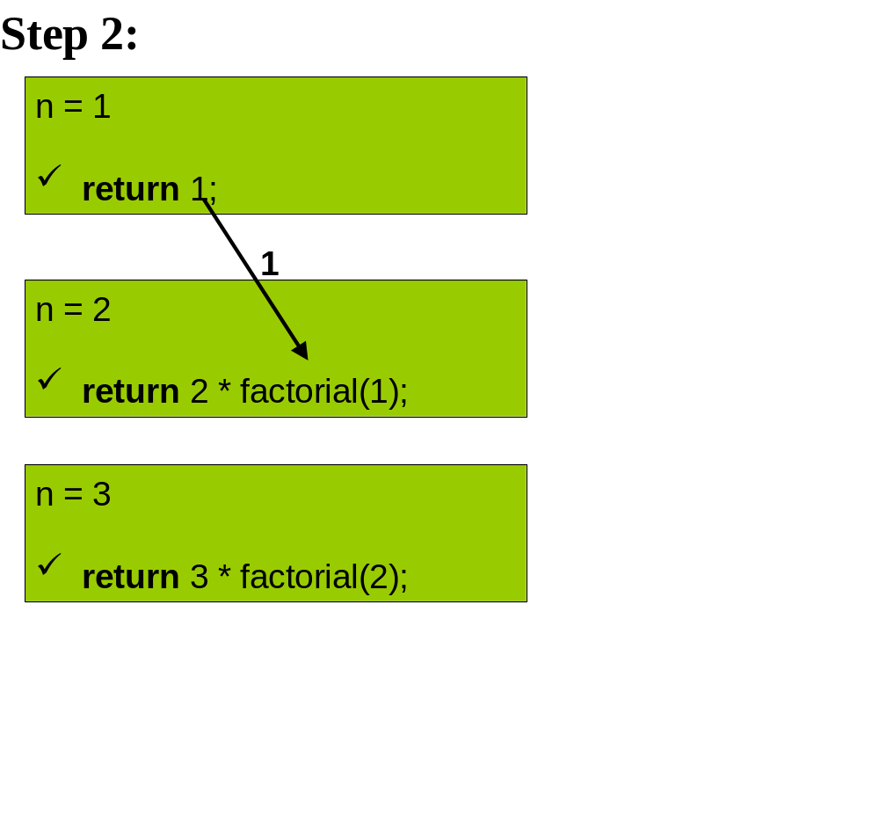

Slide 15
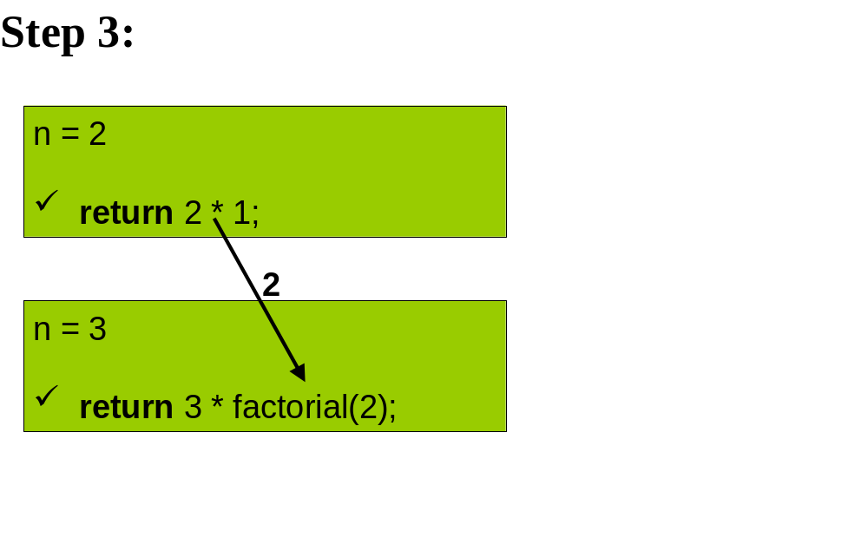

Slide 16
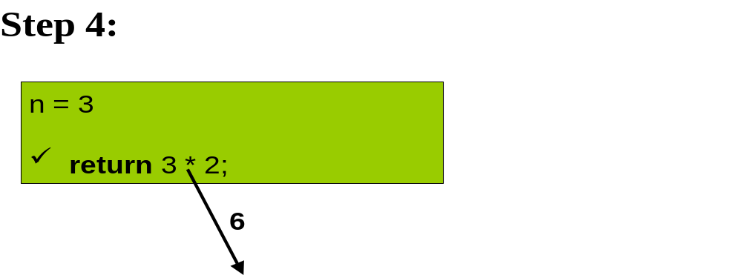

Slide 17
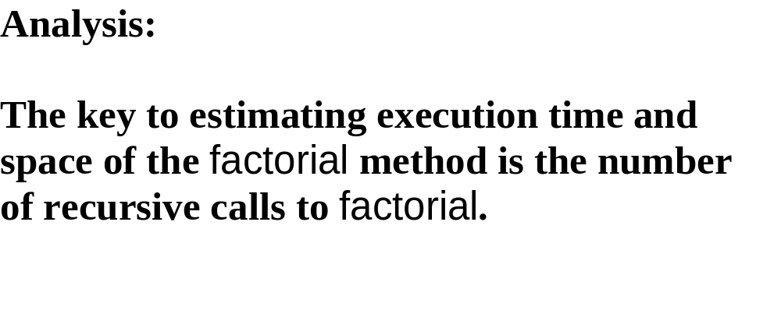

Slide 18
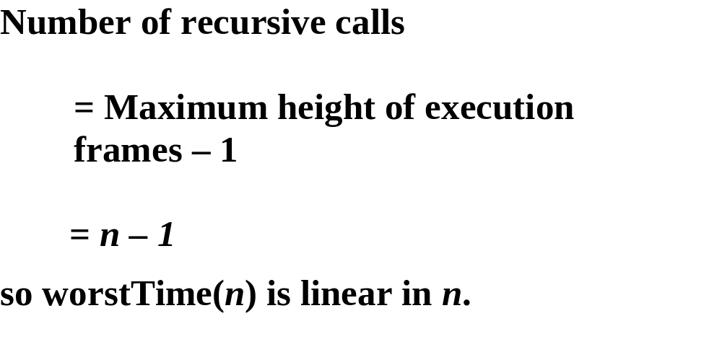

Slide 19
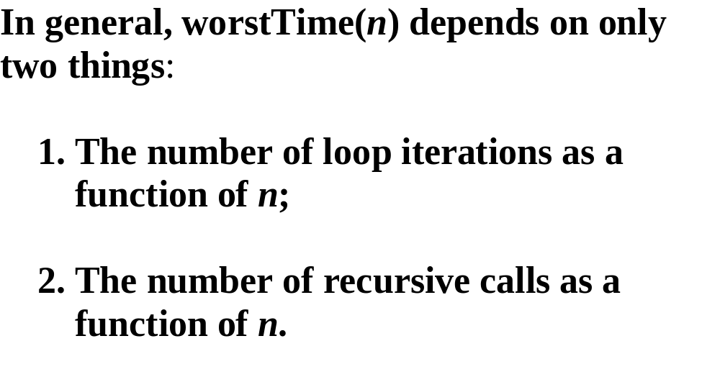

Slide 20
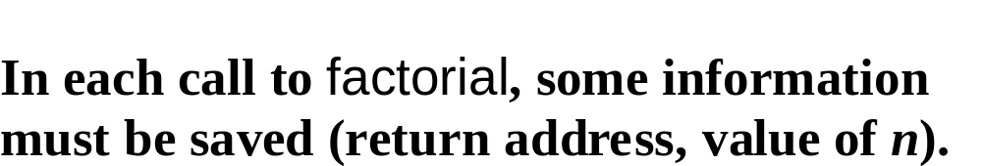

Slide 21
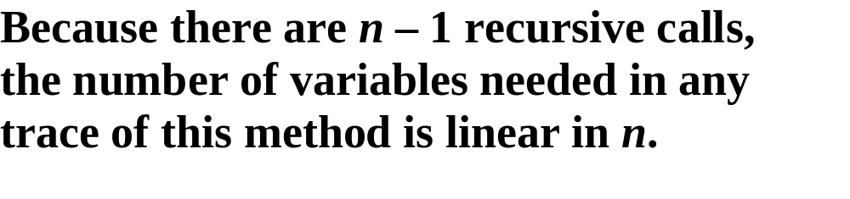

Slide 22
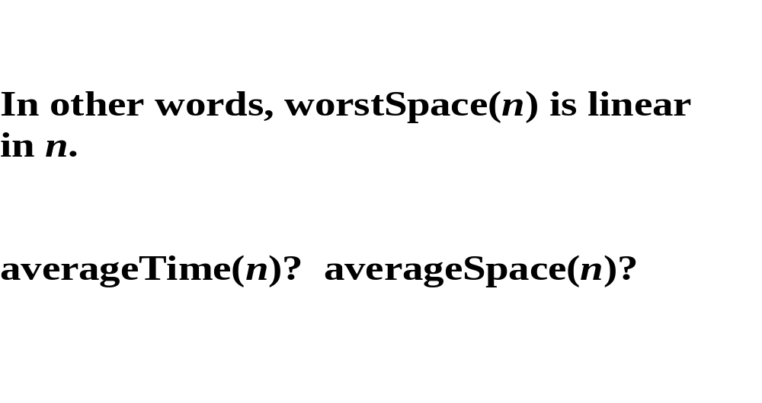

Slide 23
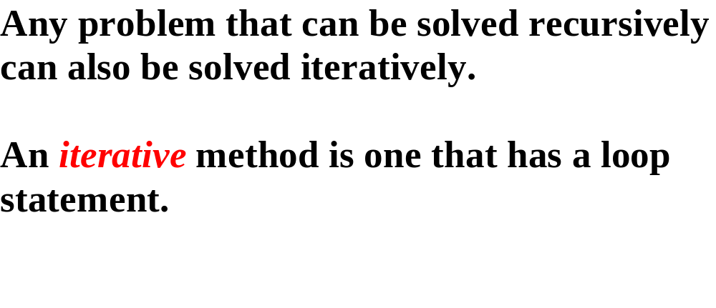

Slide 24
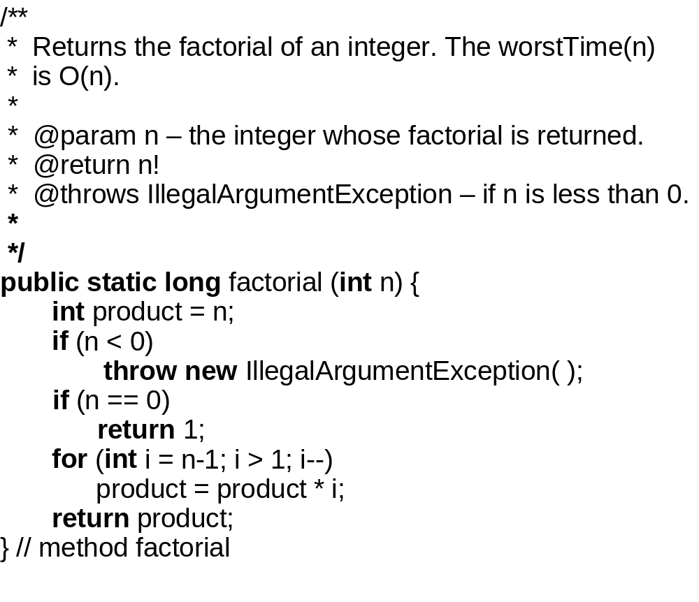

Slide 25


Slide 27
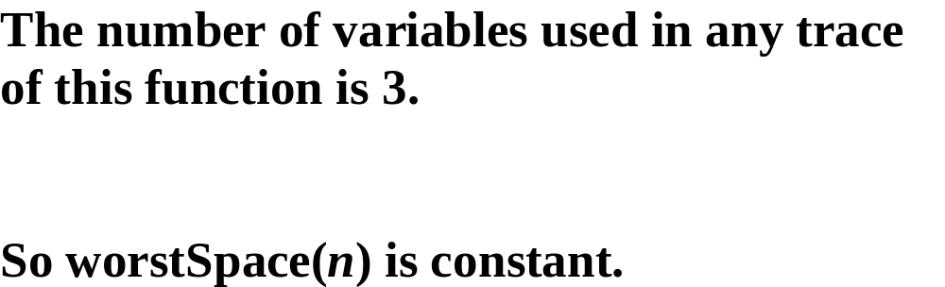

Slide 28
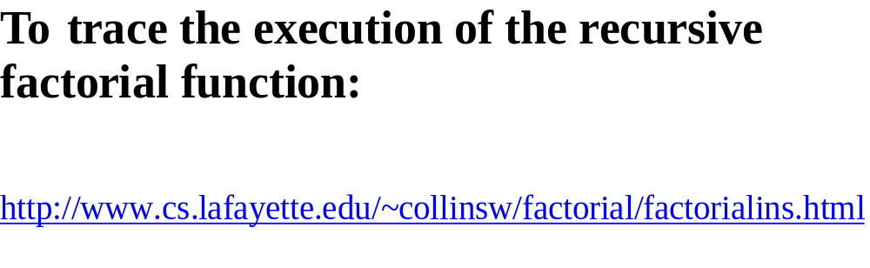

Slide 29
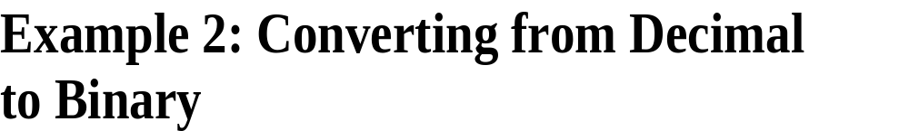

Slide 30
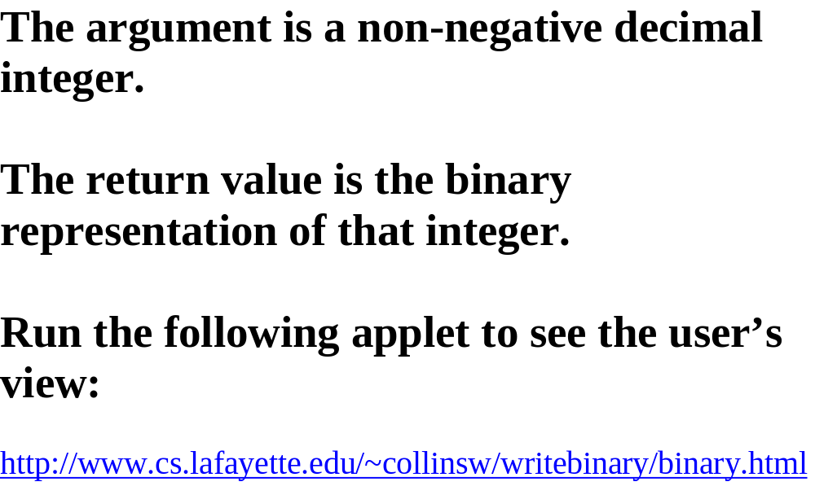

Slide 31
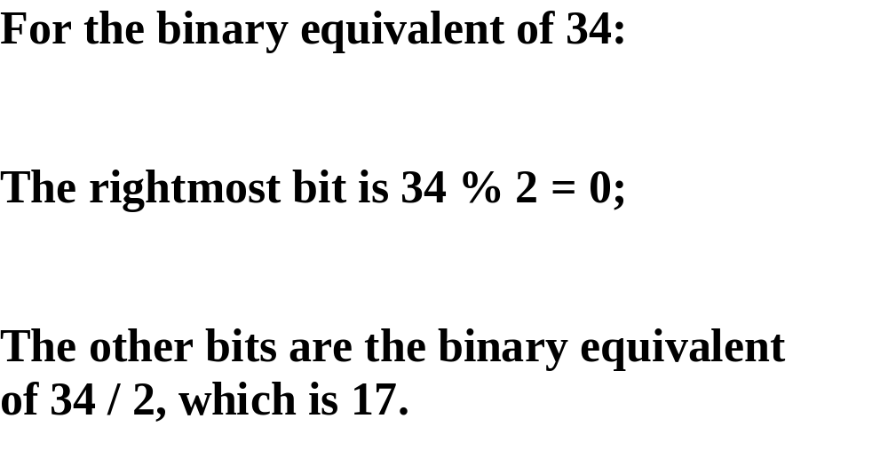

Slide 32
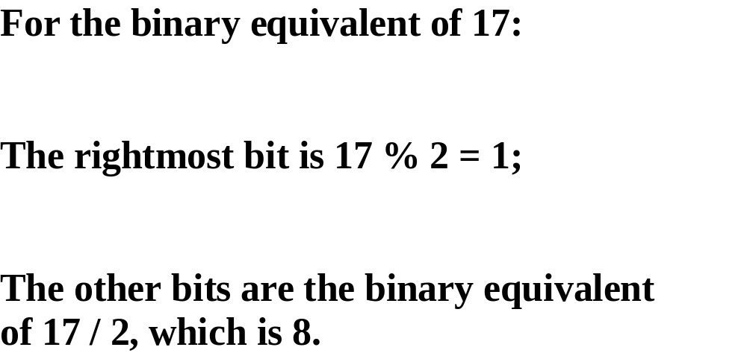

Slide 33
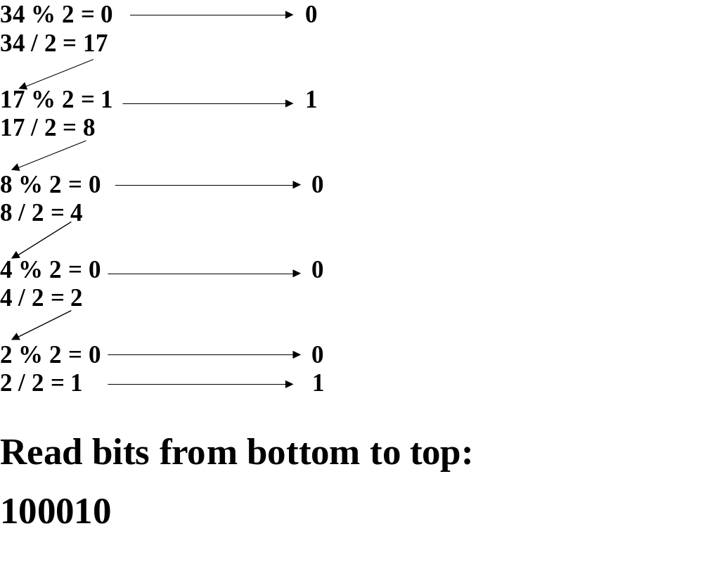

Slide 34
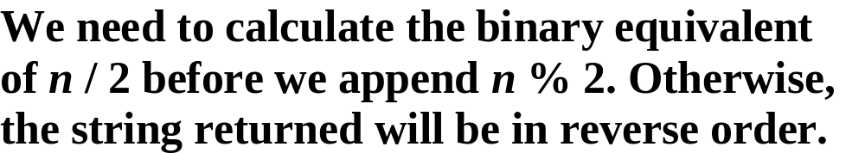

Slide 35
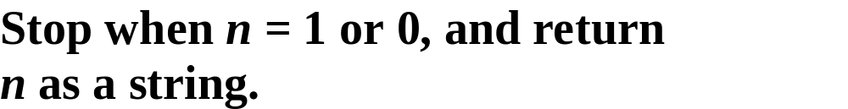

Slide 36
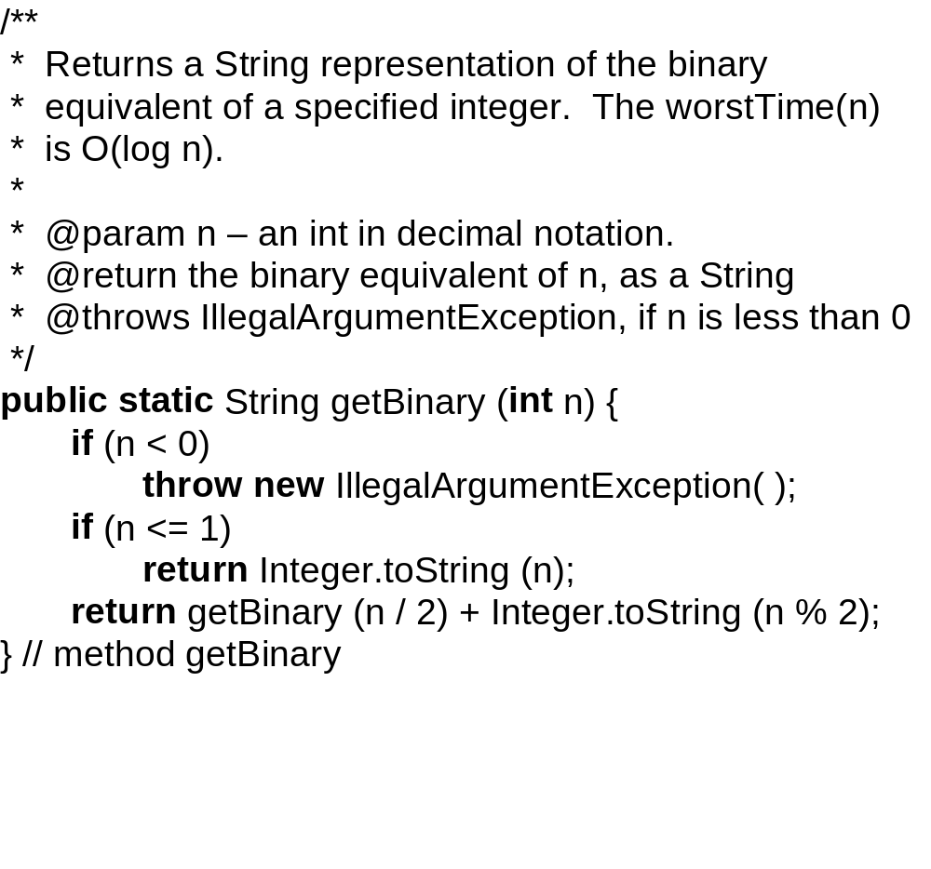

Slide 37
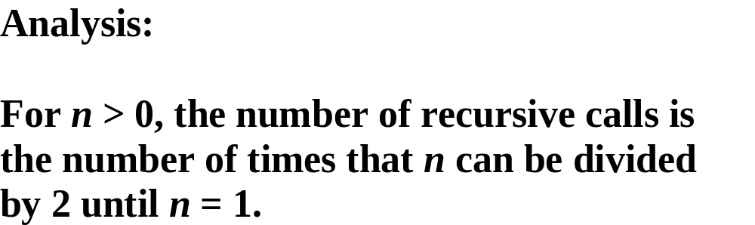

Slide 38
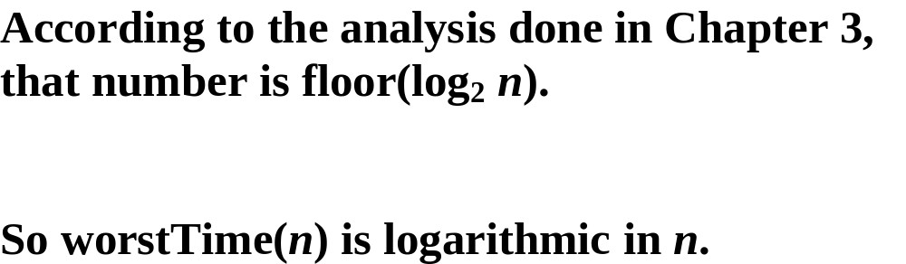

Slide 39
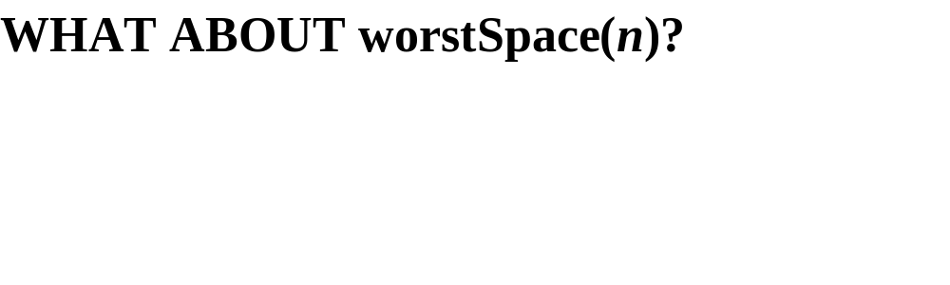

Slide 40
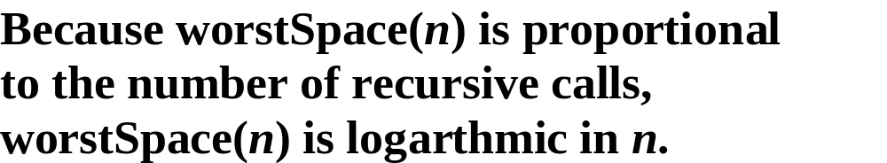

Slide 41
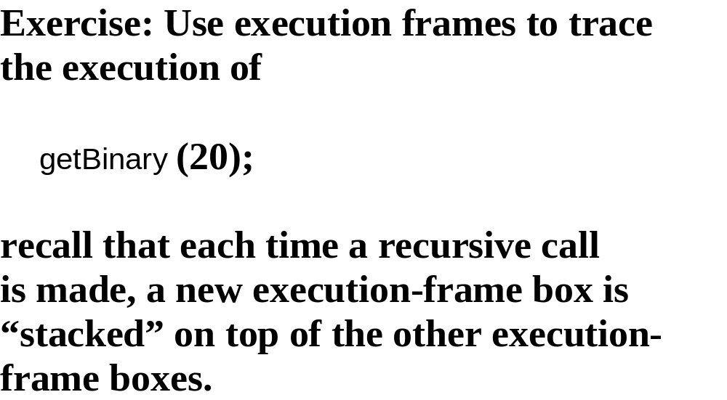

Slide 42
Example 3: Towers of Hanoi

Slide 43
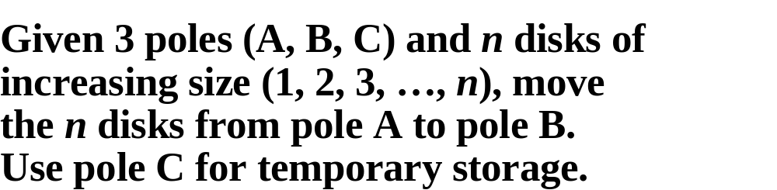

Slide 44
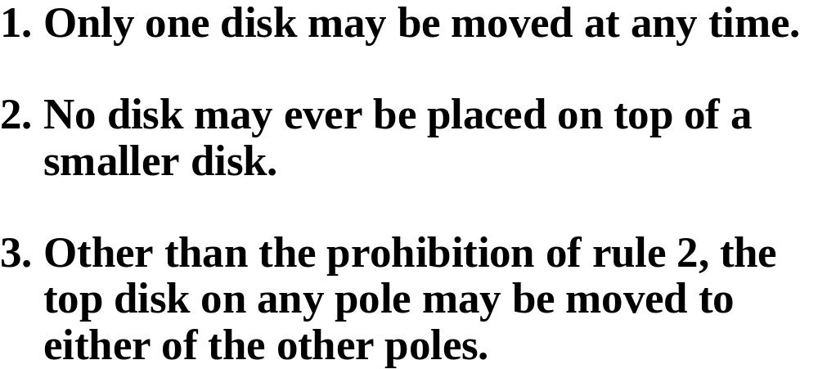

Slide 45
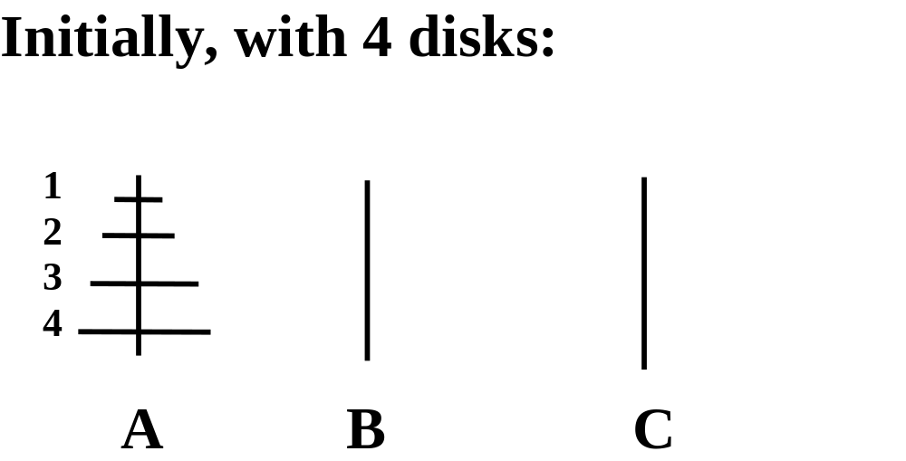

Slide 46
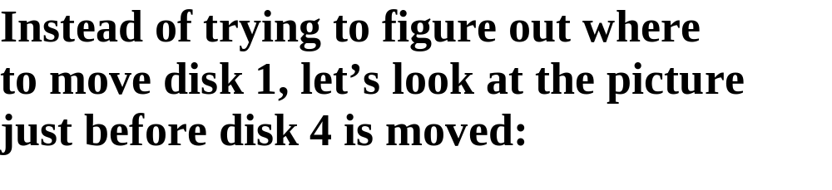

Slide 47
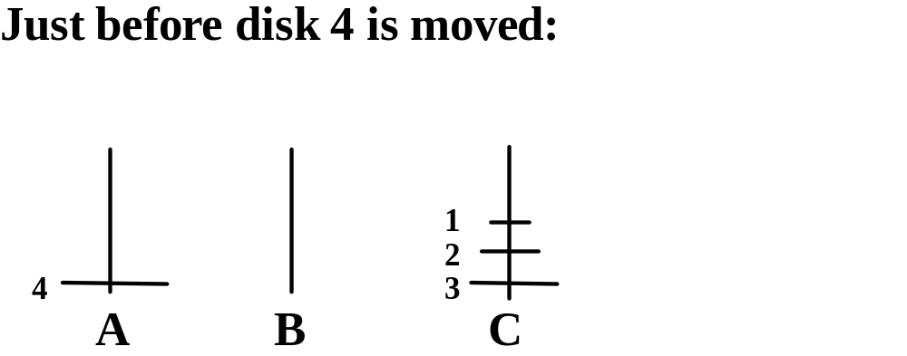

Slide 48
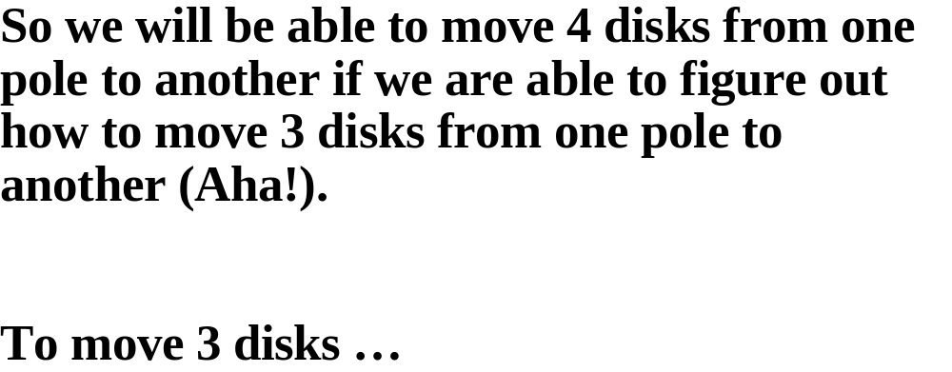

Slide 49
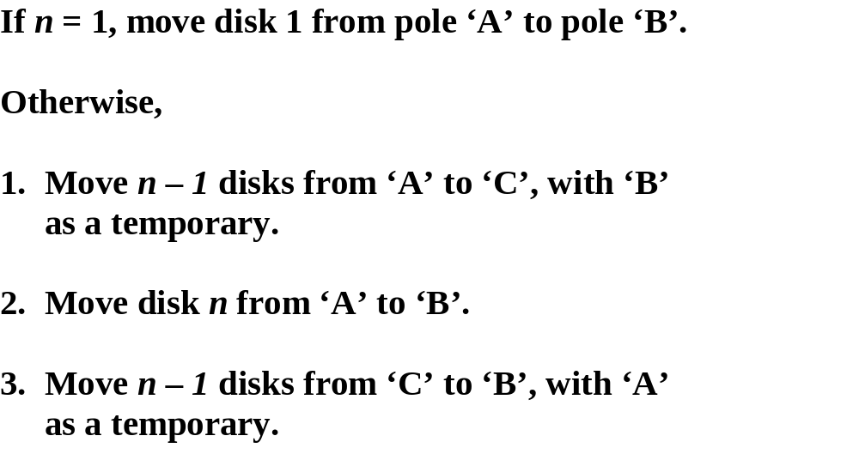

Slide 50
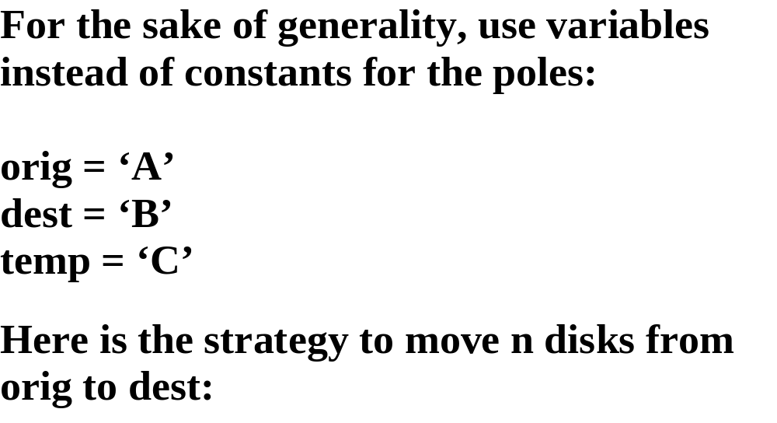

Slide 51
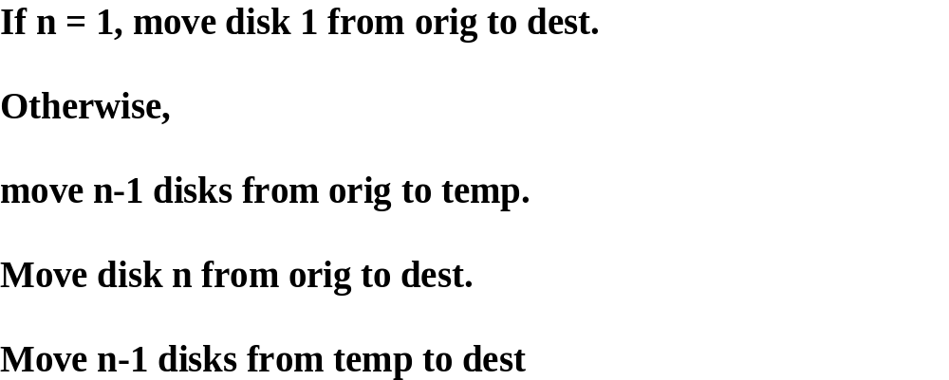

Slide 52
/**
* Determines the steps needed to move disks from an origin to a destination.
* The worstTime(n) is O(2^{n}).
*
* @param n the number of disks to be moved.
* @param orig the pole where the disks are originally.
* @param dest the destination pole
* @param temp the pole used for temporary storage.
* @return a String representation of the moves needed.
* @throws IllegalArgumentException if n is less than or equal to 0.
*/
public static String move (int n, char orig, char dest, char temp) {
final String DIRECT_MOVE =
"Move disk " + n + " from " + orig + " to " + dest + "\n";
if (n <= 0)
throw new IllegalArgumentException( );
if (n == 1)
return DIRECT_MOVE;
return move (n ‑ 1, orig, temp, dest) + DIRECT_MOVE +
move (n ‑ 1, temp, dest, orig) ;
} // method move

Slide 53
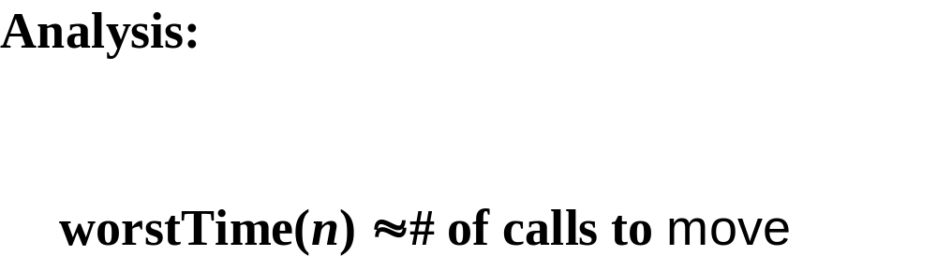

Slide 54
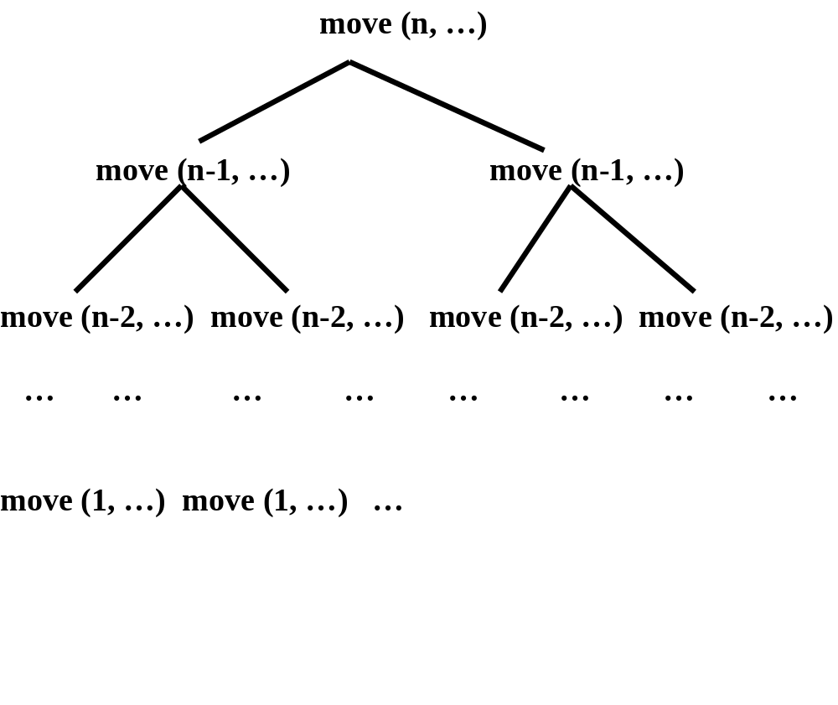

Slide 55
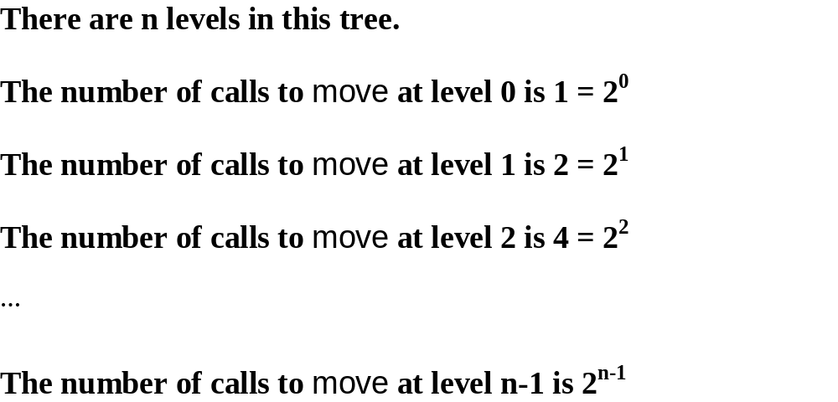

Slide 56
The total number of calls to move is:
n-1
1 + 2 + 4 + … + 2^{n-1} = Σ 2^{i}
i=0

Slide 57
n-1
Σ 2^{i} = 2^{n} - 1
i=0
See example 6 of Appendix 2 for a proof
by mathematical induction.

Slide 58
This shows that worstTime(n) is O(2^{n}),
and, because 2^{n} - 1 disks must be moved, worstTime(n) is Ω(2^{n}), that is, 2^{n} is also
a lower bound. We conclude that worstTime(n) is θ(2^{n}).

Slide 59
To trace the execution of this
recursive move function:
http://www.cs.lafayette.edu/~collinsw/hanoi2/hanoiins.html

Slide 60
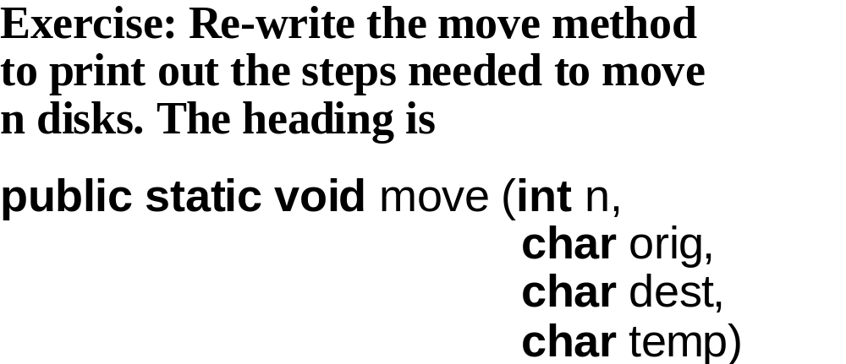

Slide 61
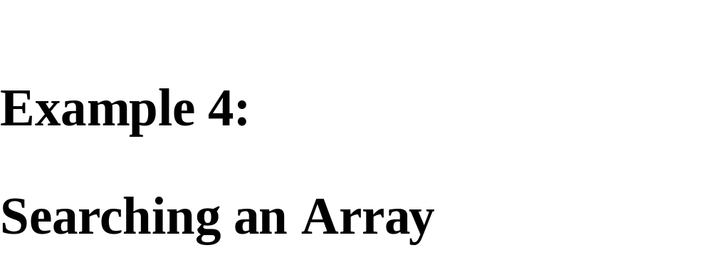

Slide 62


Slide 63


Slide 64


Slide 65


Slide 66


Slide 67


Slide 68


Slide 69


Slide 70


Slide 71


Slide 72


Slide 73


Slide 74


Slide 75


Slide 76


Slide 78


Slide 79


Slide 80


Slide 81


Slide 82


Slide 83


Slide 84


Slide 85


Slide 86


Slide 87


Slide 88


Slide 89
Example 5:
Backtracking

Slide 90
Backtracking is the strategy of trying to reach a goal by a sequence of chosen positions, with re-tracing in reverse order of positions that cannot lead to the goal.

Slide 91
Strategy: Try to go west; if unable to go west, try to go south; if unable to go south, backtrack (until you can go south). Do not go
to any position that has been shown not to lead to a goal. The goal
is either G1 or G2. Start at P1.
P3 P2 P1
P4 P5
G2 P7 P6
G1

Slide 92
When a position is visited, it is marked as (potentially) being on a path to the goal.
If we discover otherwise, the marking must be undone, so that position will never again be visited. For example, P4 is not visited
from P5.

Slide 93
We will solve this maze-search problem within the general framework of backtracking, which can easily be
utilized in other applications.

Slide 94
The Application interface and the Backtrack class are the same for any backtracking project.

Slide 95
import java.util.*;
public interface Application {
// Returns true if it pos is a legal position and not a dead end.
boolean isOK (Position pos);
// Marks pos as possibly being on a path to a goal position.
void markAsPossible (Position pos);
// Returns true if pos is a goal position.
boolean isGoal (Position pos);

Slide 96
// Marks pos as not being on a path to a goal position.
void markAsDeadEnd (Position pos);
// Returns a string representation of this Application.
String toString();
// Returns an iterator over the positions directly
// accessible from pos.
Iterator<Position> iterator (Position pos);
} // interface Application

Slide 97


Slide 98


Slide 99


Slide 100


Slide 101


Slide 102


Slide 103


Slide 104


Slide 105


Slide 106
Maze searching: 1 = Corridor;
0 = Wall
start 1 1 1 0 1 1 0 0 0 1 1 1 1
        1 0 1 1 1 0 1 1 1 1 1 0 1
        1 0 0 0 1 0 1 0 1 0 1 0 1
        1 0 0 0 1 1 1 0 1 0 1 1 1
        1 1 1 1 1 0 0 0 0 1 0 0 0
        0 0 0 0 1 0 0 0 0 0 0 0 0
        0 0 0 0 1 1 1 1 1 1 1 1 1 finish
Iterator choices: north, east, south, west
Marked as possible = 9; dead end = 2

Slide 107


Slide 108
Solution: 9 = Path; 2 = dead end
      9 9 9 0 2 2 0 0 0 2 2 2 2
      1 0 9 9 9 0 2 2 2 2 2 0 2
      1 0 0 0 9 0 2 0 2 0 2 0 2
      1 0 0 0 9 2 2 0 2 0 2 2 2
      1 1 1 1 9 0 0 0 0 1 0 0 0
      0 0 0 0 9 0 0 0 0 0 0 0 0
      0 0 0 0 9 9 9 9 9 9 9 9 9

Slide 109
All that need to be developed are the
Position class, the class that implements
the Application interface and a tester.
For this application, a position is simply
a row and column, so:

Slide 110


Slide 111


Slide 112


Slide 113


Slide 114


Slide 115


Slide 116


Slide 117


Slide 118


Slide 119
Exercise: Recall the solution when the order was north, east, south, west:
9 9 9 0 2 2 0 0 0 2 2 2 2
      1 0 9 9 9 0 2 2 2 2 2 0 2
      1 0 0 0 9 0 2 0 2 0 2 0 2
      1 0 0 0 9 2 2 0 2 0 2 2 2
      1 1 1 1 9 0 0 0 0 1 0 0 0
      0 0 0 0 9 0 0 0 0 0 0 0 0
      0 0 0 0 9 9 9 9 9 9 9 9 9

Slide 120
Re-solve with the order north, east, west, south:
start 1 1 1 0 1 1 0 0 0 1 1 1 1
        1 0 1 1 1 0 1 1 1 1 1 0 1
        1 0 0 0 1 0 1 0 1 0 1 0 1
        1 0 0 0 1 1 1 0 1 0 1 1 1
        1 1 1 1 1 0 0 0 0 1 0 0 0
        0 0 0 0 1 0 0 0 0 0 0 0 0
        0 0 0 0 1 1 1 1 1 1 1 1 1 finish
        Hint: Only one ‘1’ remains.

Slide 121


Slide 122


Slide 123


Slide 124


